Slide 1

PGP AI ML – Capstone Interim Submission
Group A CV Batch 1

Slide 2
Automating Pneumonia screening in chest radiographs and providing affected area details through powerful AI techniques can assist physicians to make better clinical decisions
Background - Pneumonia accounts for over 15% of all deaths of children under 5 years old internationally. Accurately diagnosing pneumonia requires review of a chest radiograph (CXR) by highly trained specialists and confirmation through clinical history, vital signs and laboratory exams. Pneumonia usually manifests as an area or areas of increased opacity on CXR. However, the diagnosis of pneumonia on CXR is complicated because of a number of other conditions in the lungs such as fluid overload (pulmonary edema), bleeding, volume loss (atelectasis or collapse), lung cancer, or post-radiation or surgical changes. Outside of the lungs, fluid in the pleural space (pleural effusion) also appears as increased opacity on CXR. CXRs are the most commonly performed diagnostic imaging study. A number of factors such as positioning of the patient and depth of inspiration can alter the appearance of the CXR, complicating interpretation further. In addition, clinicians are faced with reading high volumes of images every shift. Tissues with sparse material, such as lungs which are full of air, do not absorb the X-rays and appear black in the image. Dense tissues such as bones absorb X-rays and appear white in the image
Problem statement - We need to build a Pneumonia detection model to detect a visual signal for pneumonia in medical images. Specifically, the algorithm needs to automatically locate lung opacities on chest radiographs, providing affected area details through bounding box
Data Description: Data provided is Dicom original images: - Medical images are stored in a special format called DICOM files (*.dcm). They contain a combination of header metadata as well as underlying raw image arrays for pixel data. While we are theoretically detecting “lung opacities”, there are lung opacities that are not pneumonia related. In the data, some of these are labeled “Not Normal No Lung Opacity”. This extra third class indicates that while pneumonia was determined not to be present, there was nonetheless some type of abnormality on the image and oftentimes this finding may mimic the appearance of true pneumonia

Slide 3

Exploratory Data Analysis

Slide 4
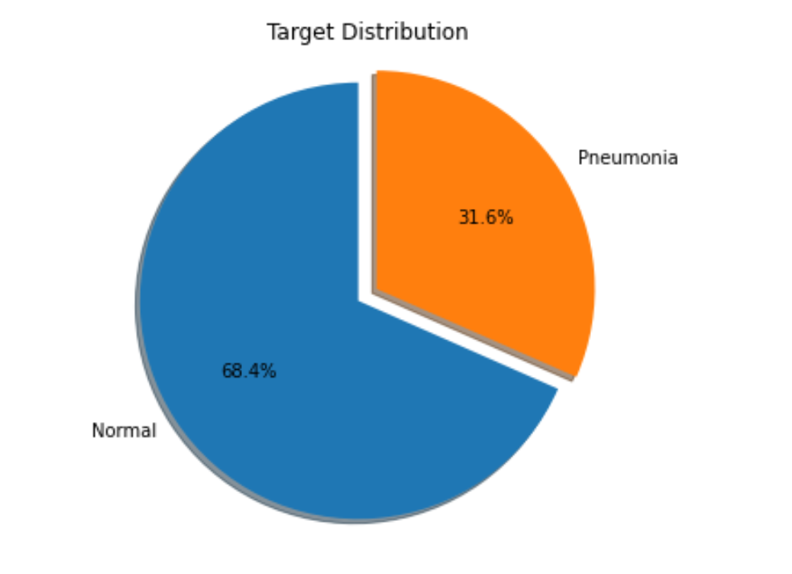
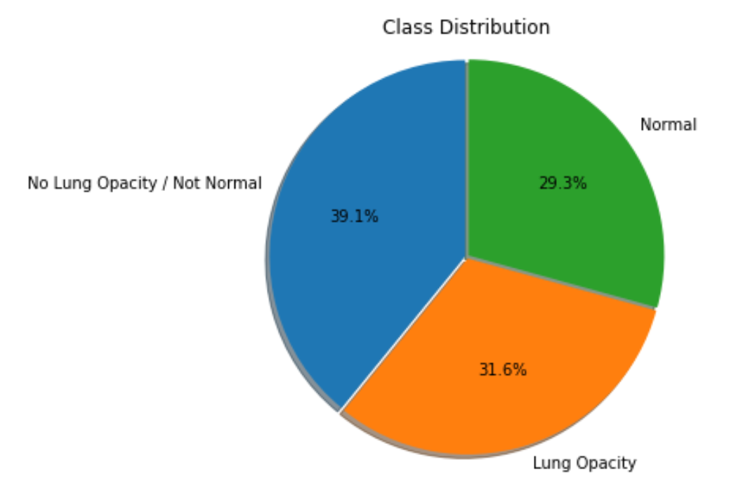
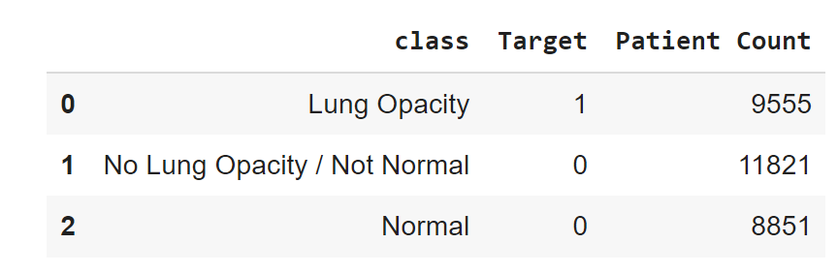
Used pydicom library to read Dicom images
26684 unique patientIDs
Few patients have multiple bounding boxes
3266 patients have 2 bounding boxes defined
119 patients have 3 bounding boxes defined
13 patients have 4 bounding boxes defined
We will run a binary classification to predict patients with pneumonia
Target – 1 indicates patients with pneumonia and target – 0 indicates normal patients or patients having lung opacity but not pneumonia
8,851 (29.3%) patients are healthy/Normal
9,555 (31.6%) patients have Lung Opacity
11,821 (39.1%) patients have No Lung Opacity but may have other lung abnormality

Slide 5
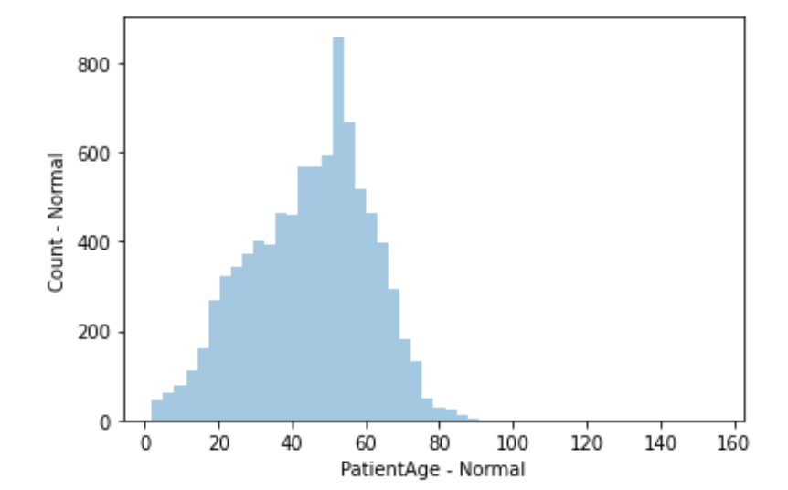
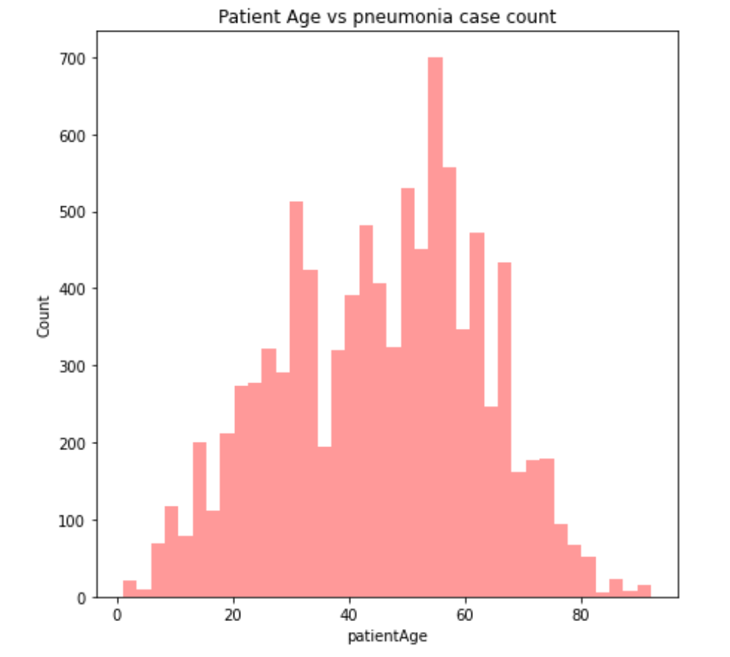
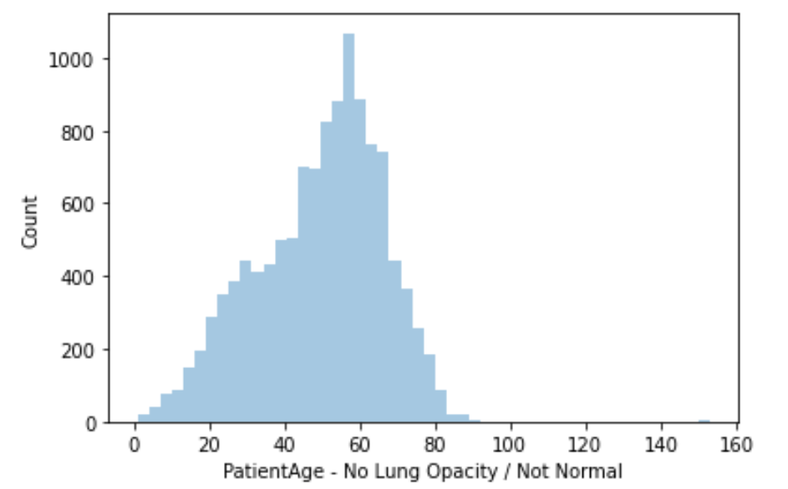
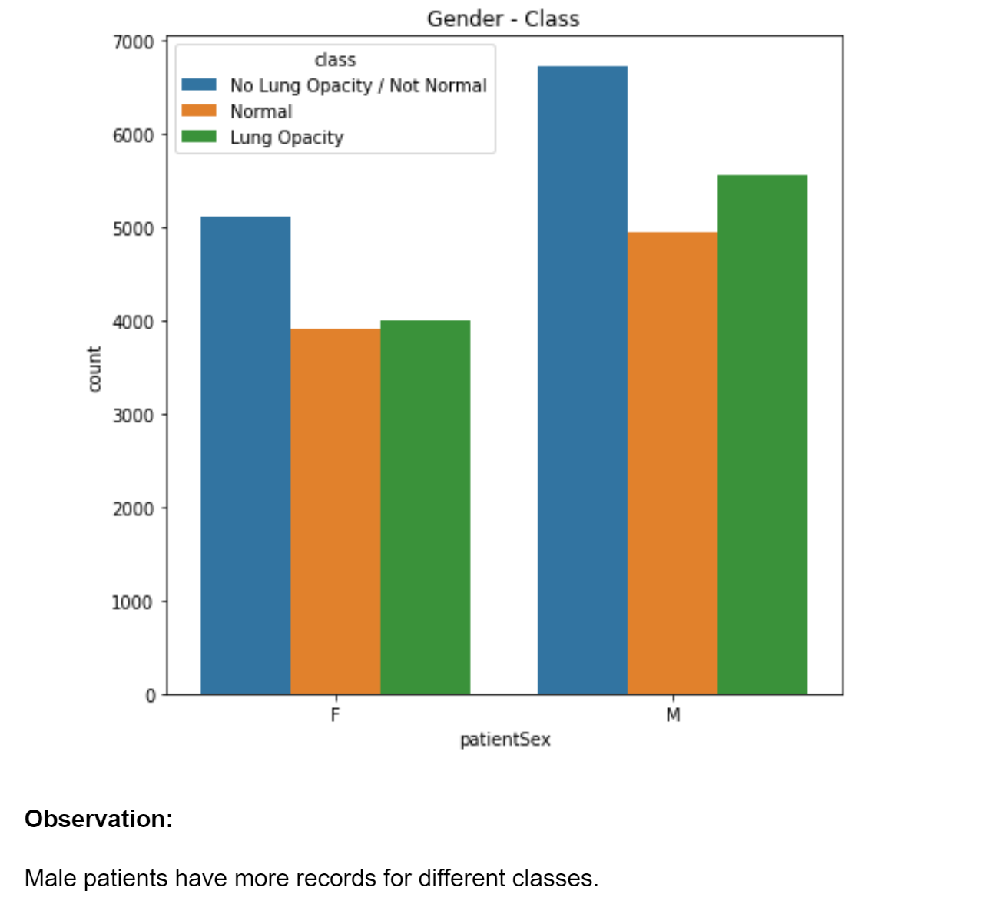
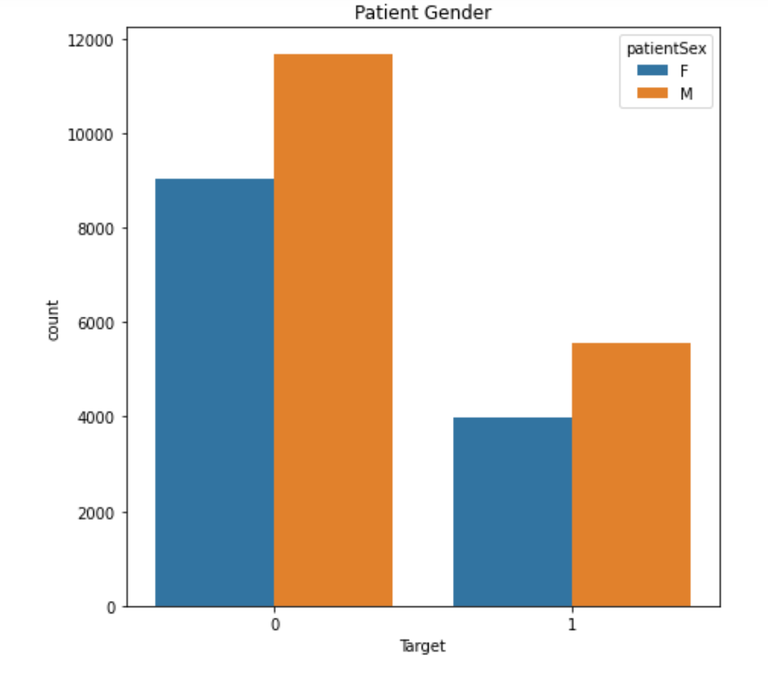
Patient distribution shows most pneumonia patients or patients are found between age 40-60
More records for male is observed in the data
Proportion of pneumonia and normal patients re equal for female patients
However, for males, proportion of pneumonia patients are more than normal

Slide 6

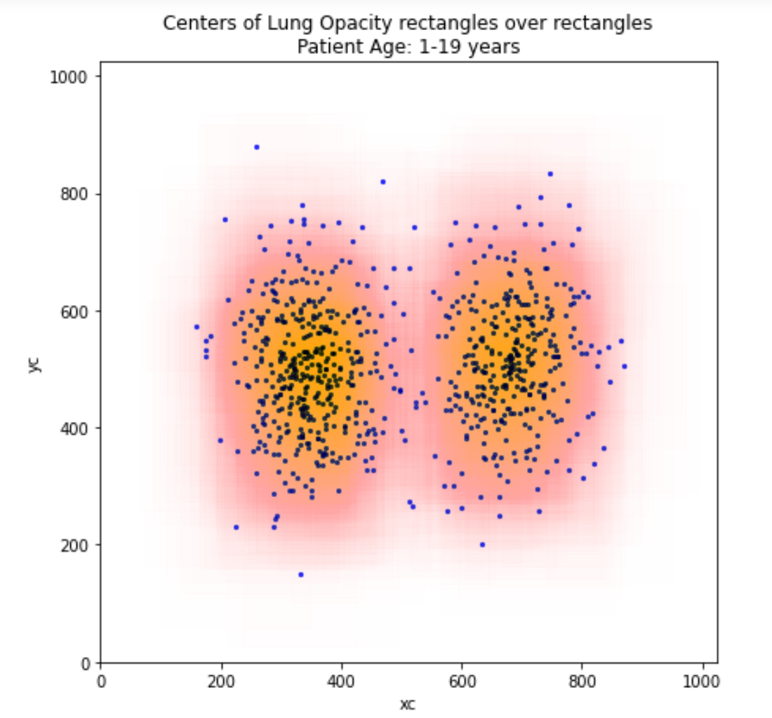
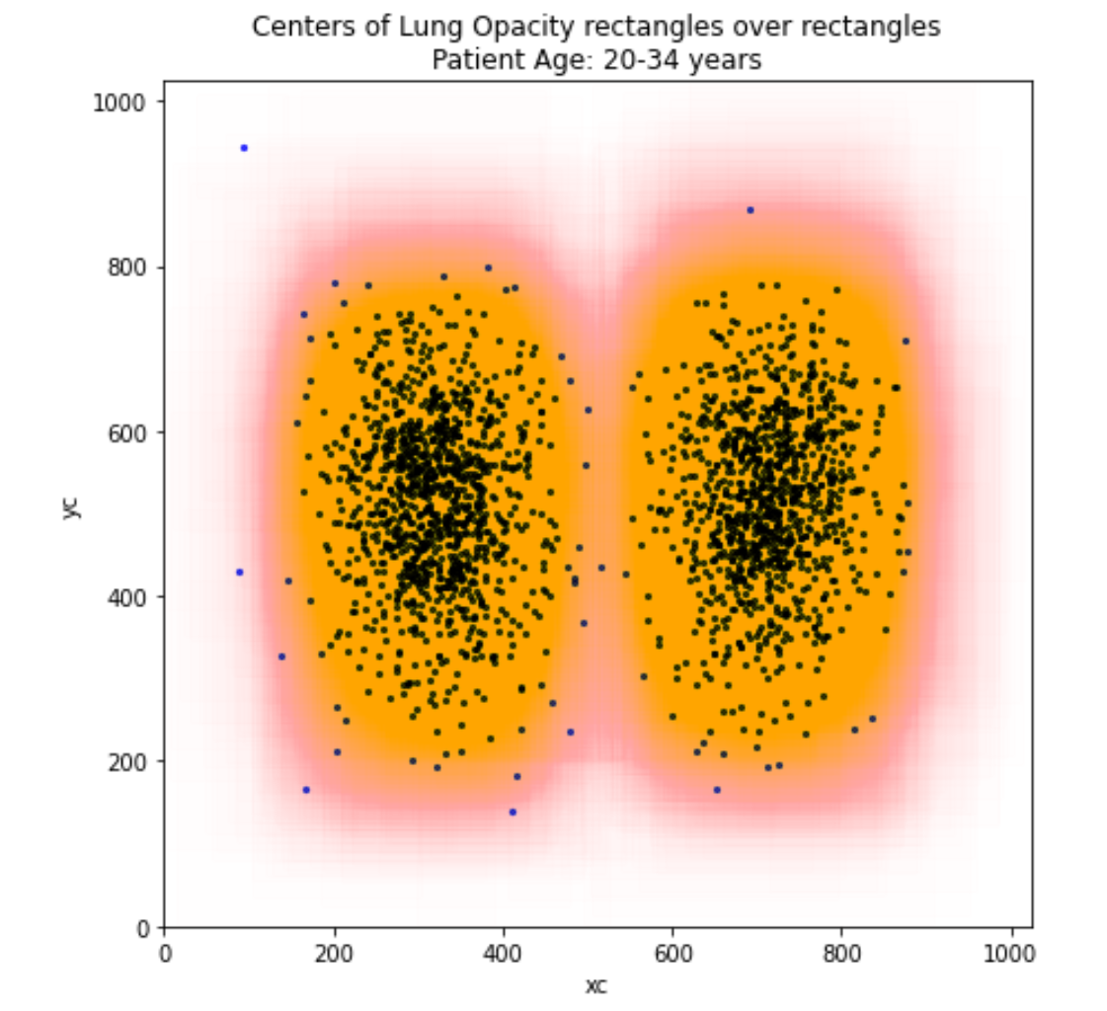
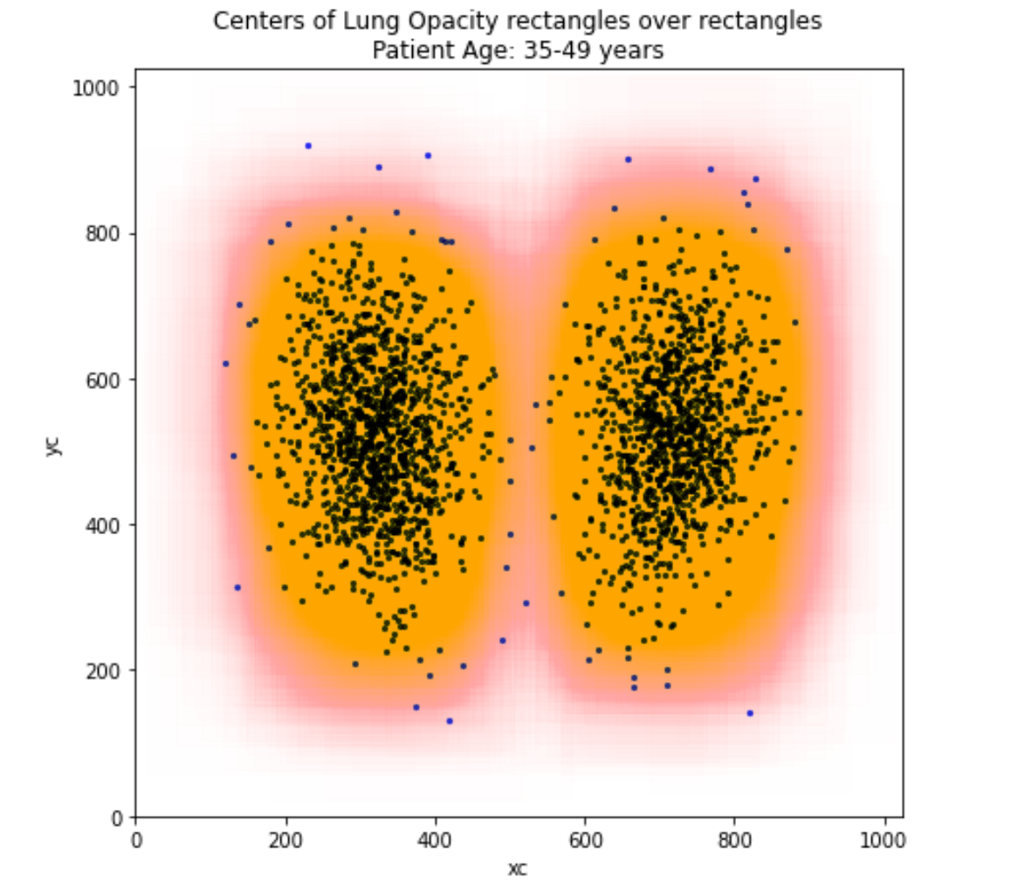
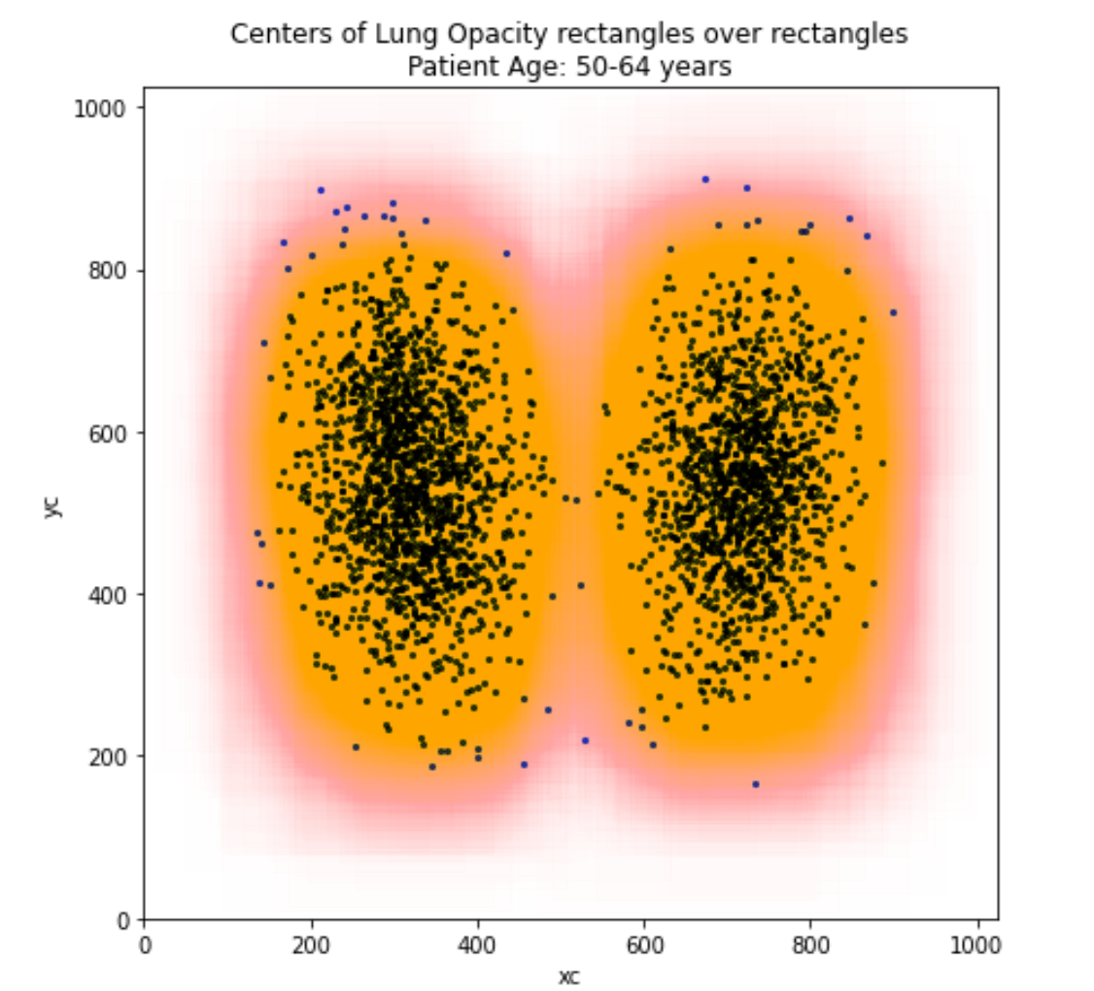
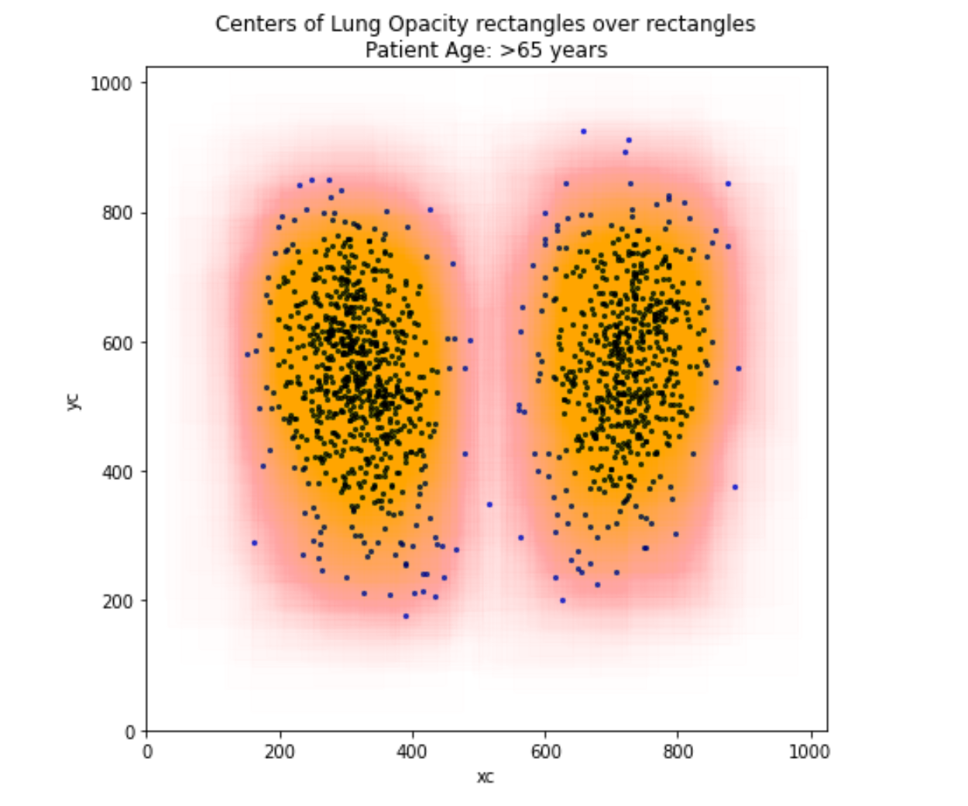
Lung opacity is seen maximum in age 50-65 followed by age group 20-50

Slide 7

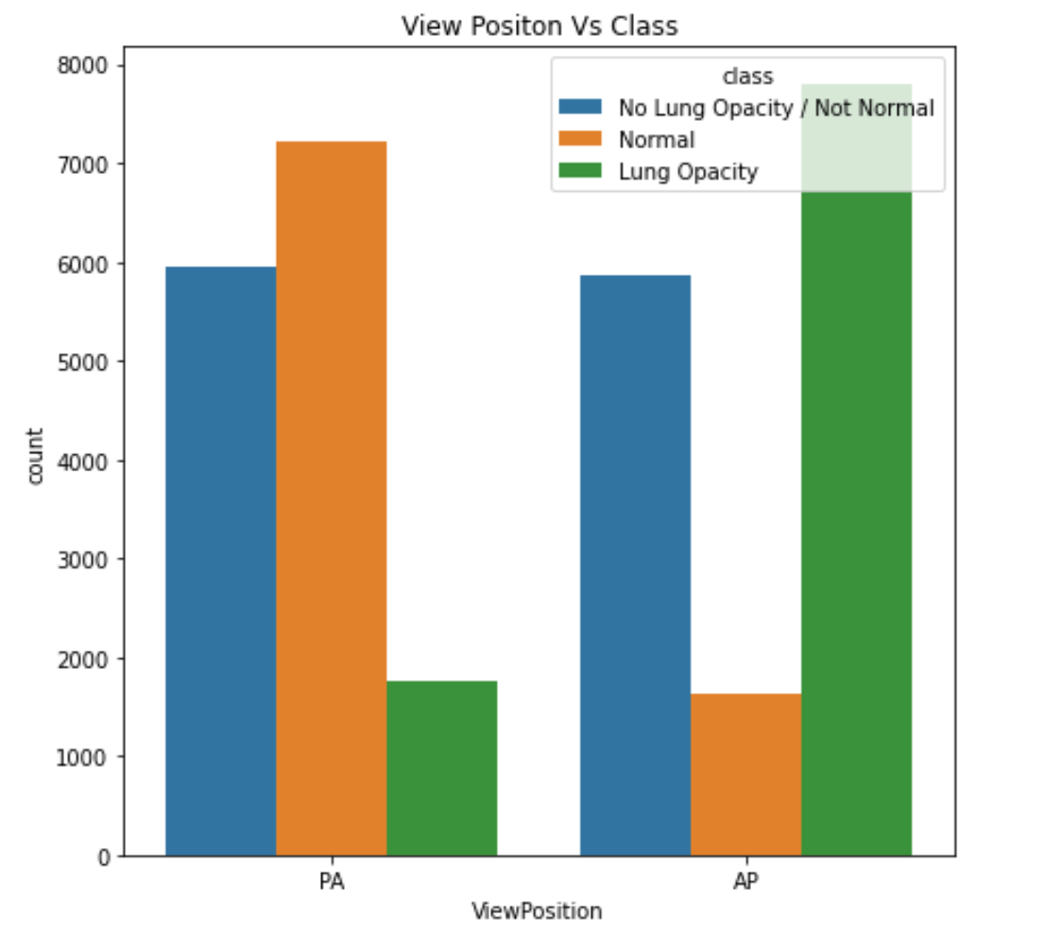
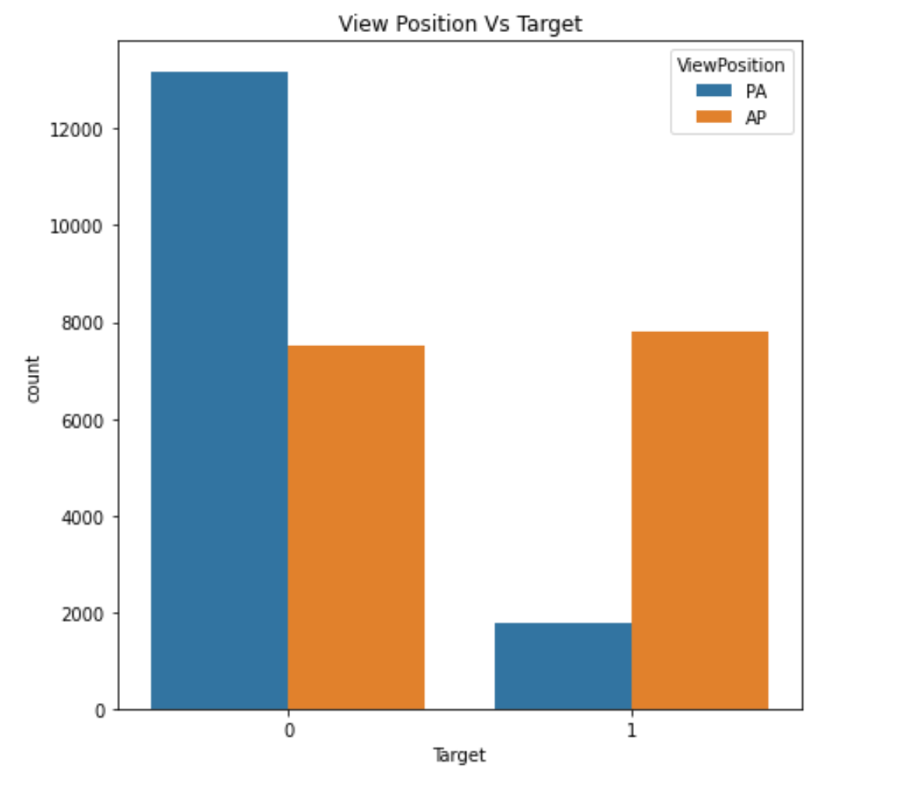
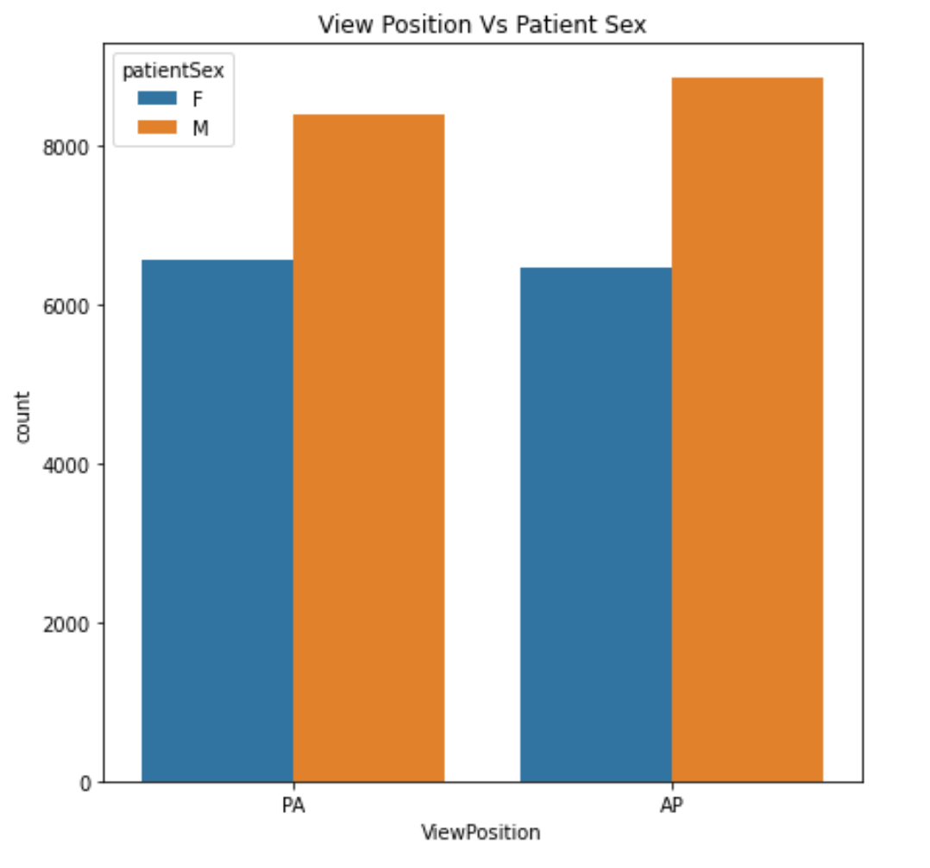
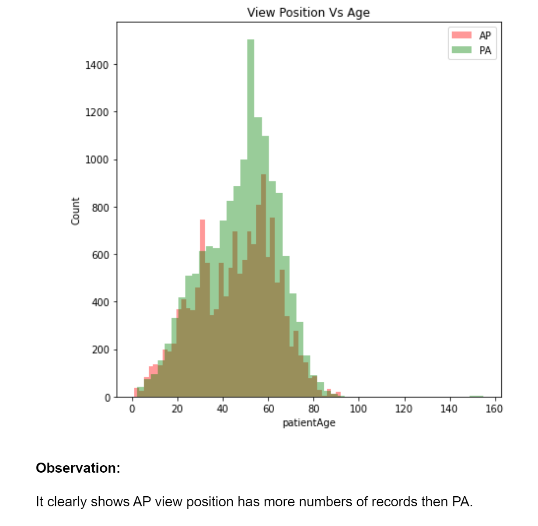
Chest X-ray can be done in Posterior-Anterior (PA) projection and Anterior-Posterior (AP) Projection
Lung opacity seems to be more visible in AP position

Slide 8
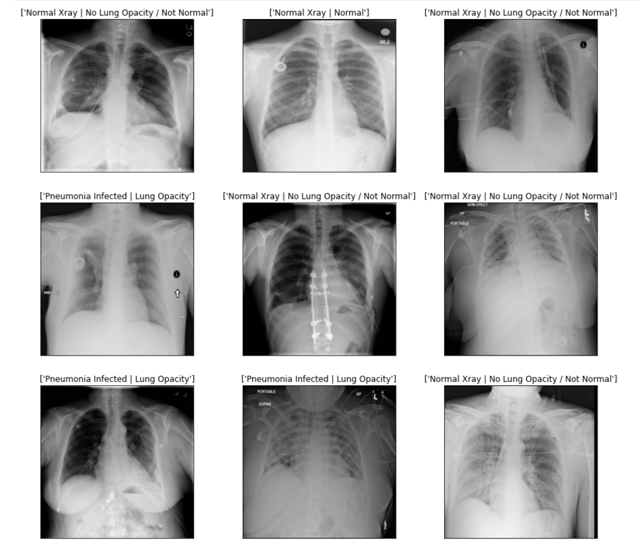
Visualization of sample X-ray images for each category

Slide 9
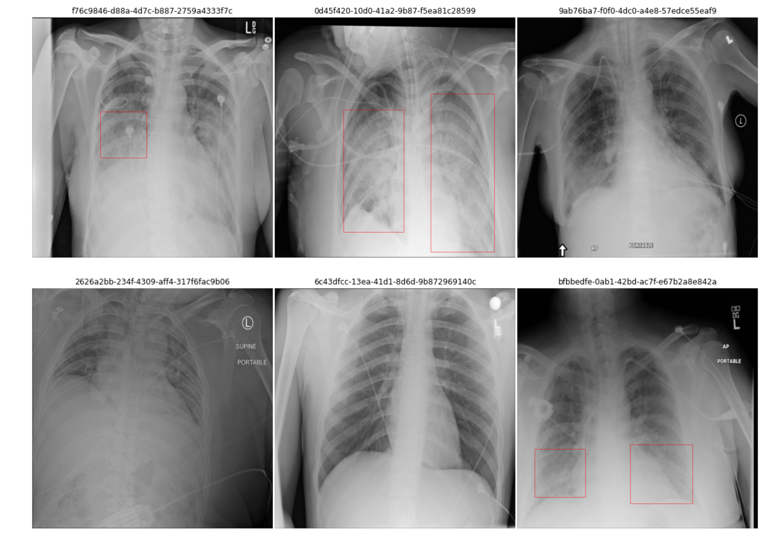
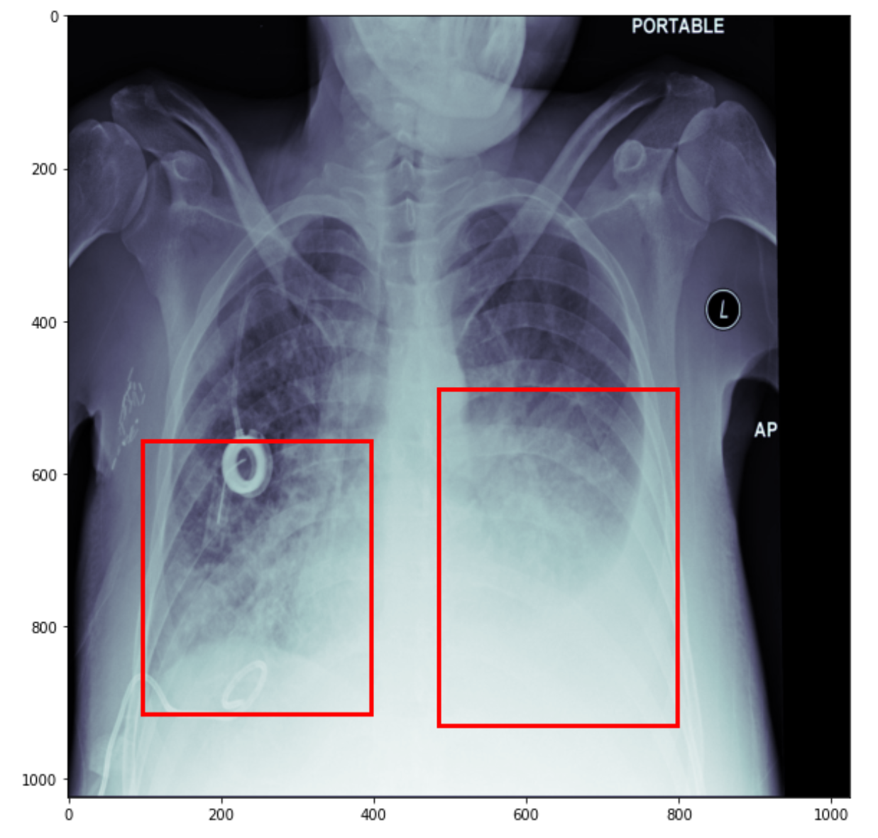
Visualization of sample X-ray images with bounding boxes

Slide 10

Model Building

Slide 11

Since the problem statement requires us to read images, we use CNN and various state of the art deep learning architectures listed here to identify lung opacity with higher accuracy and recall
Architectures | Accuracy | Precision | Recall | AUC-ROC
Basic CNN
UNet
Faster RCNN | 78.4% | 69% | 15%
VGG19 | 87% | 66% | 78% | 93.22%
VGG16 | 85% | 64% | 91% | 98.09%
ResNet50 | 82% | 74% | 91% | 90.55%
InceptionNet v3 | 86% | 55% | 81% | 86.8%
From the consolidated results, VGG19 seems to be the best model with highest recall

Slide 12
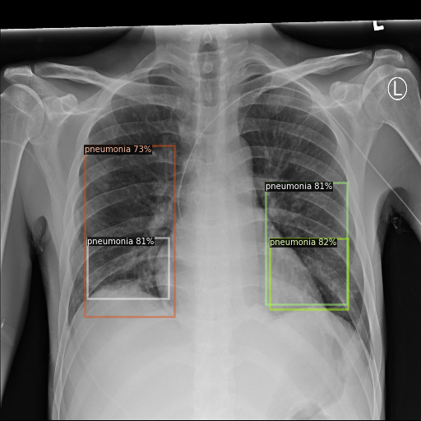
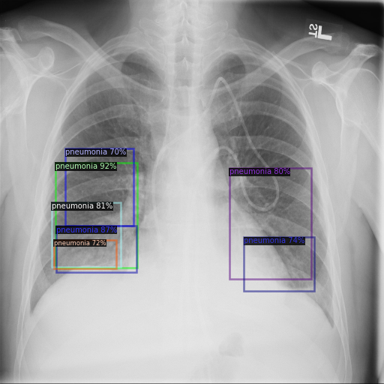
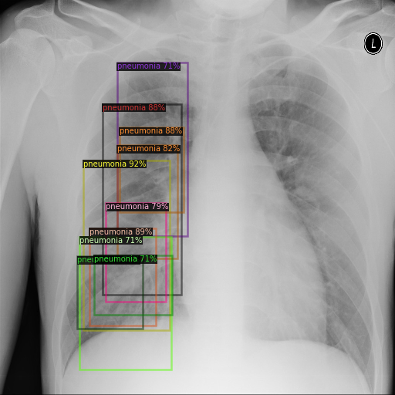
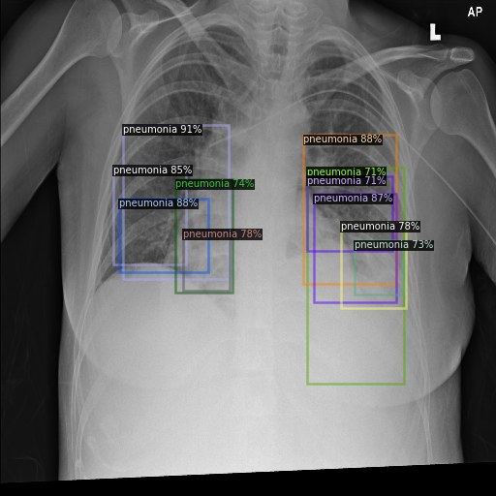
Few cases of “Faster RCNN” model predicting bounding boxes of pneumonia patients with confidence intervals

